Slide 1
Cross cultural communication
Dr. V.K. Karthika

Slide 2
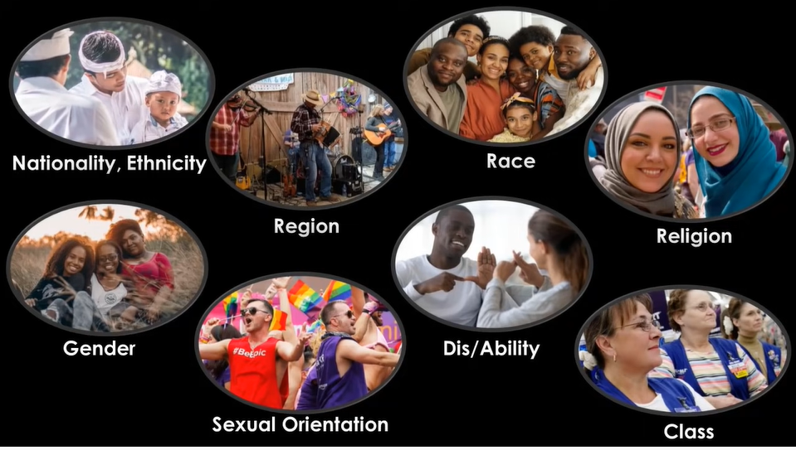

Slide 3
Cross cultural communication
“On a planet of 8 billion people and countless sub-cultures, there’s no one correct way to communicate cross-culturally, but human beings are wired to respond to genuine bids for connection.“- Sara Murdoch
The ability to communicate effectively and appropriately in various cultural contexts

Slide 4
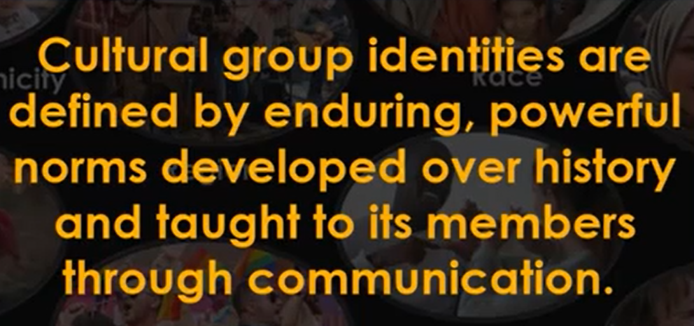
Culture and identity

Slide 5
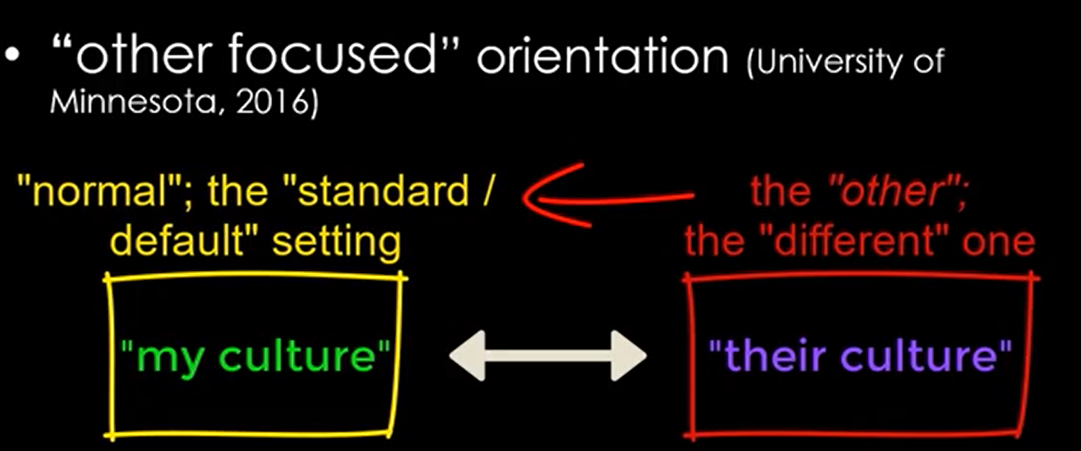
Challenge- 1

Slide 6
Challenge-2
Ethnocentricism-
Our tendency to view our culture as superior to other cultures
Geographical boundaries are porous- ethnocentric attitudes impair communication
Conscious attempts to understand various cultures- need of the day

Slide 7
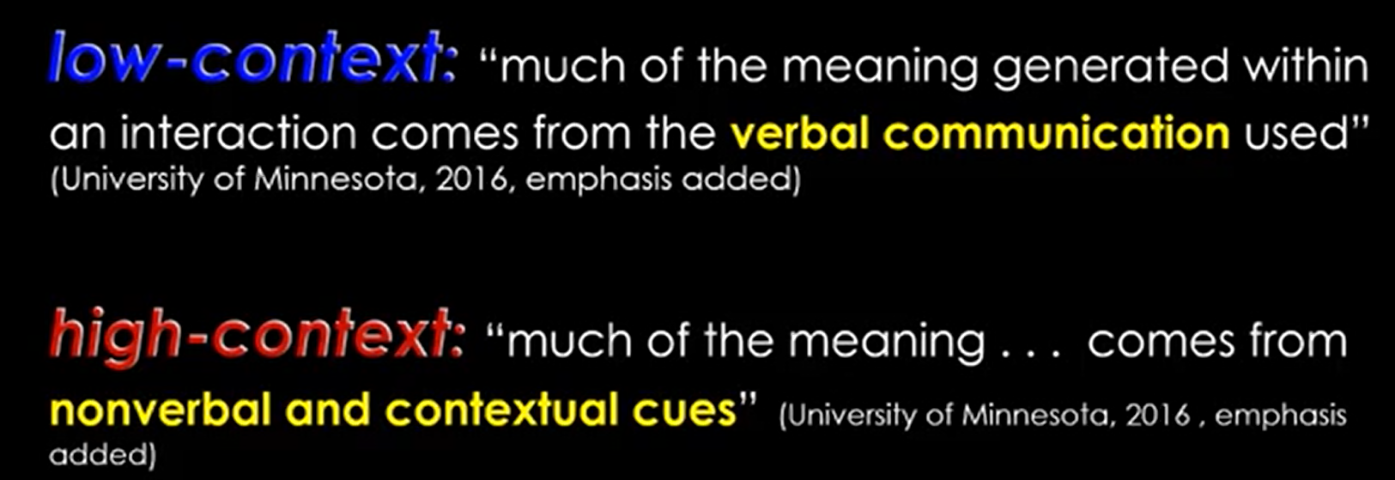
Low context and High context cultures

Slide 8
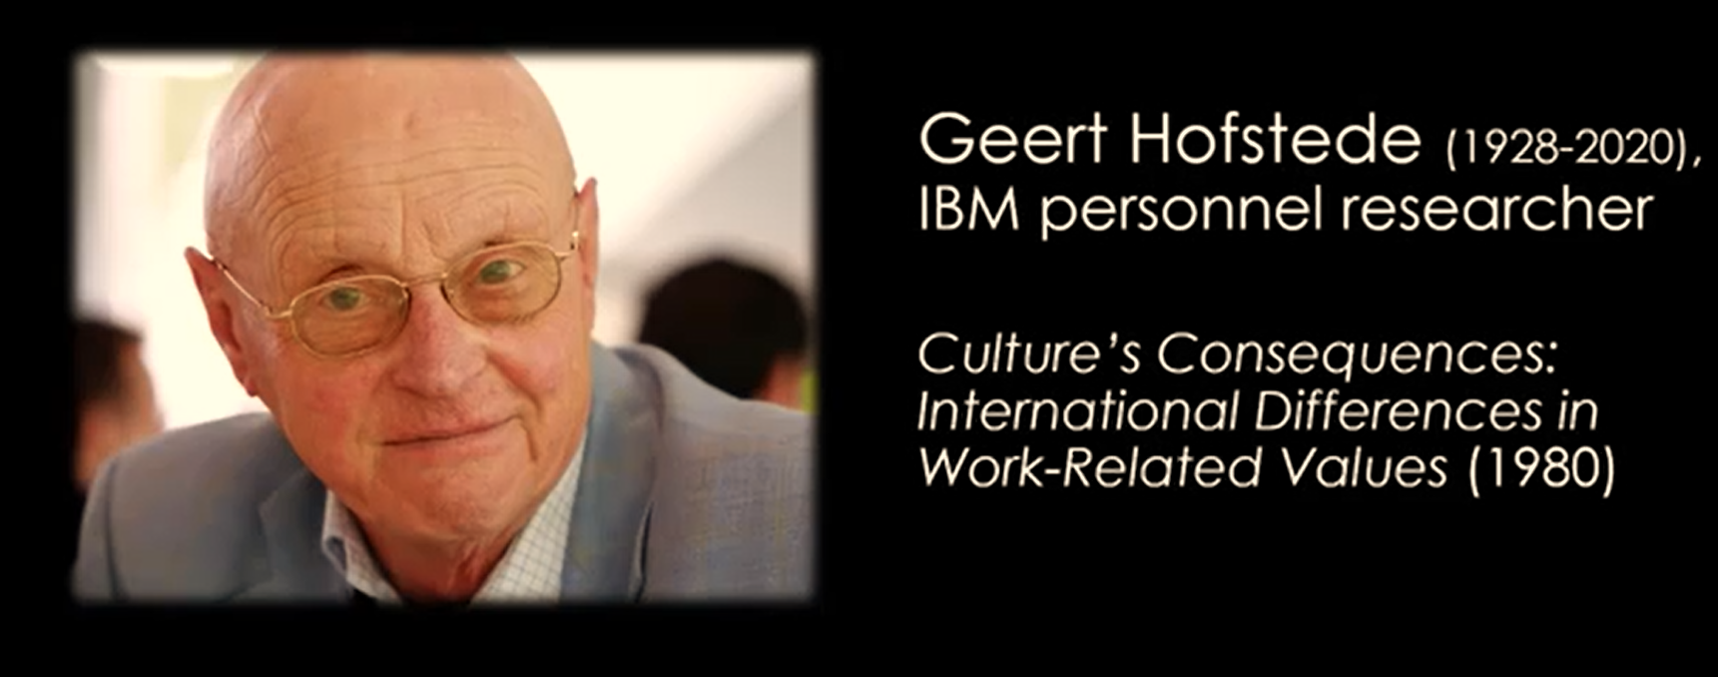
6 Dimensions of cultural communication

Slide 9
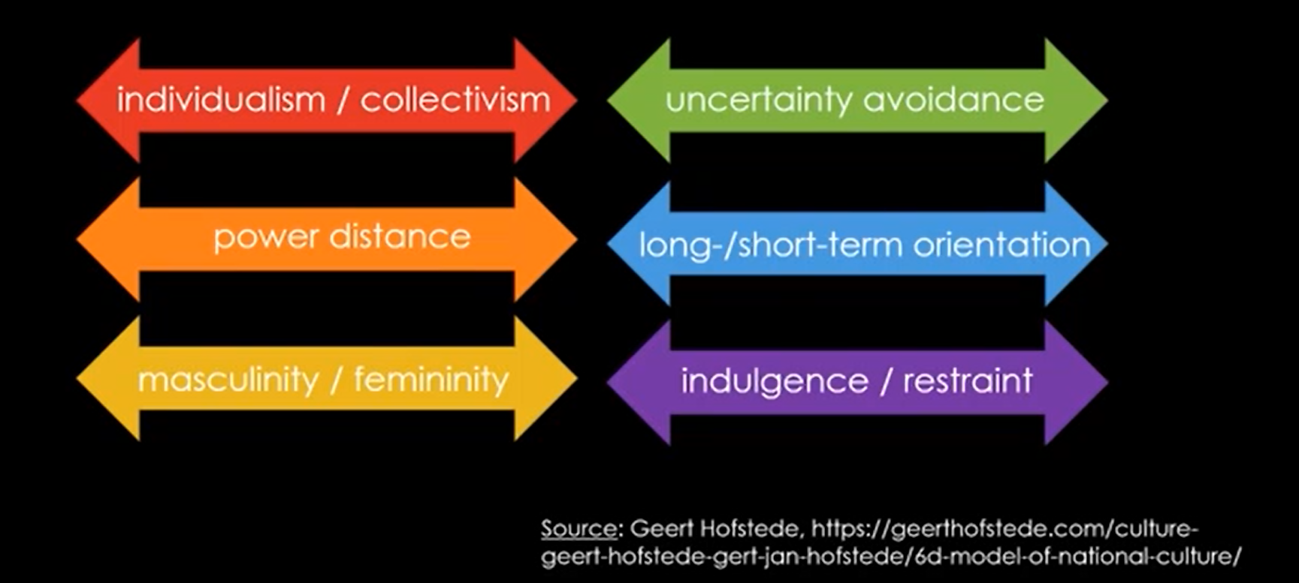
Dimensions of cultural communication

Slide 10
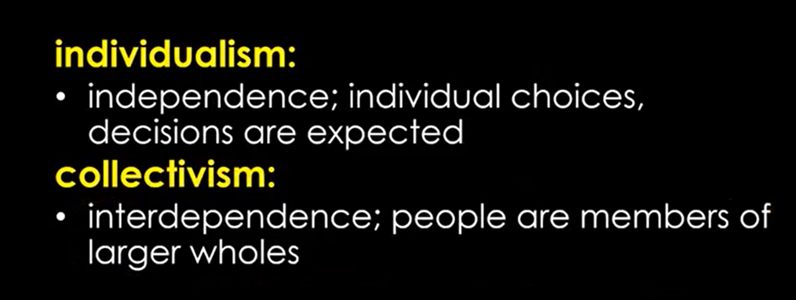
Collectivism and Individualism

Slide 11
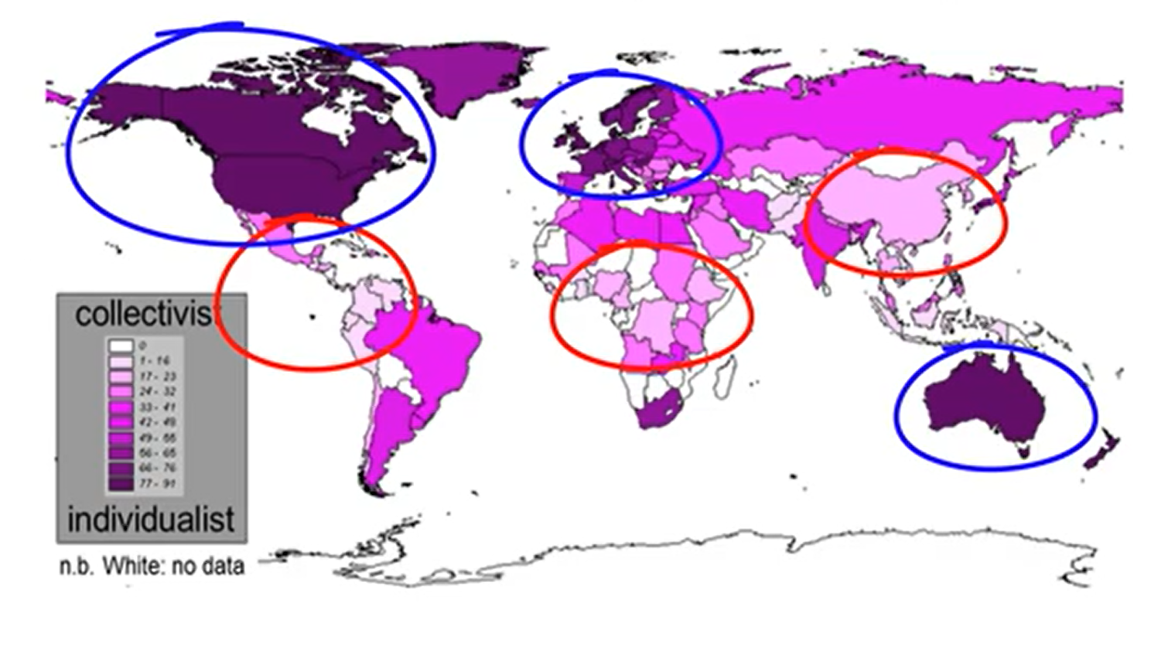
Collectivism and Individualism world map

Slide 12
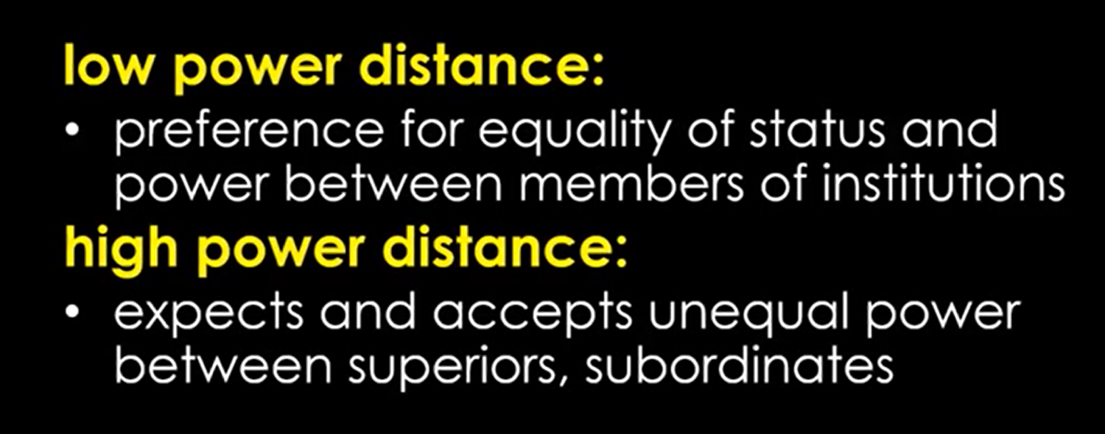
Power distance- Low power & High power

Slide 13
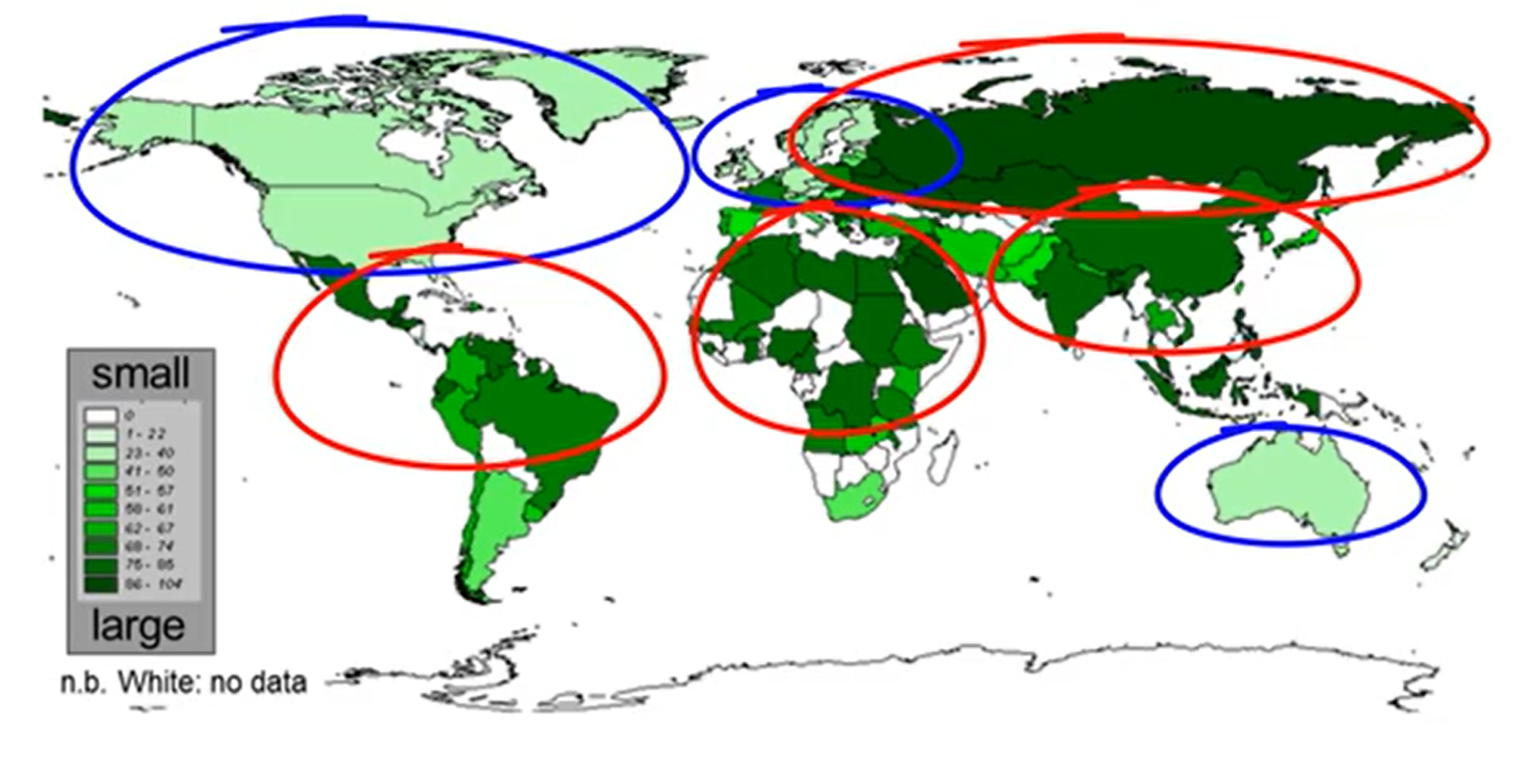
Power distance- World map

Slide 14
The Joy Luck Club- Movie clip where Mr. Rich is being introduced to the lady’s parents.

Slide 15
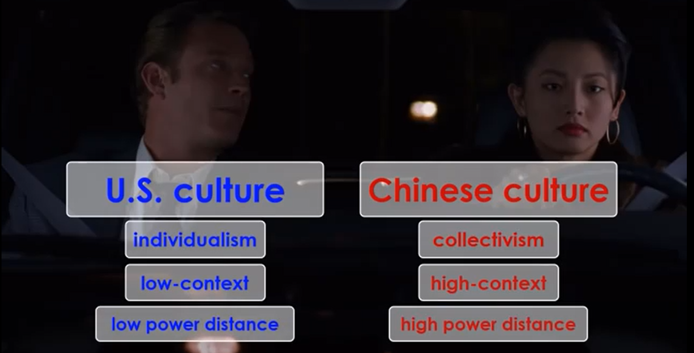

Slide 16
Example 1
Linda Johnson, a senior marketing manager from New York is traveling to Paris, for a meeting with her French associates. During her flight, she is going through her notes and presentation for the last time before the big meeting tomorrow morning. Everything’s on point. She covered all the issues and is looking forward to exchanging ideas with her colleagues from overseas.
Cut to the next day. It’s time for the big meeting. A little bit jet-lagged, but still eager to do business with her French colleagues, Linda enters the conference room. Claude Truffaut, her co-worker from Paris, welcomes her with a peck on the cheek. “What’s going on?” Linda thinks to herself. Did he misinterpret something she said in her email?

Slide 17
Example 1
Linda has nothing to worry about. Namely, kissing a business associate is an acceptable greeting in Paris, although it’s considered inappropriate in the U.S.
All she had to do was prepare herself for a different culture, by reading a bit about French business people and their business etiquette.
Needless to say, Claude should have done the same, so as not to startle his co-worker.

Slide 18
Example 2
Klaus Schmidt, a project manager at an IT company from Leipzig, is expecting a new addition to their team – Maria Silva, an IT engineer from Rio de Janeiro. Finally, Maria has arrived and Klaus has prepared a meet and greet for her. He invited all the colleagues from her future team, and they can’t wait to meet her. However, just as the meeting had started and Klaus began explaining the project to Maria, she interrupted him and took control of the meeting. Everyone apart from Klaus was flabbergasted by her behavior. Why was Klaus so cool and collected?

Slide 19
Example 2
He has done some research about business etiquette in Brazil and knows that Brazilians are at ease with overlapping conversations and interruptions. As a matter of fact, they see these interruptions as signs of engagement

Slide 20
What is cross-cultural communication in the workplace?
Cross-cultural communication in the workplace deals with understanding different business customs, beliefs, and communication strategies.
It occurs when people from different cultural backgrounds communicate with each other.
Since we live in the age of globalization, it is only natural that employers are not exclusively confined to hiring people in their close proximity.
As more and more people are working remotely, there are plenty of opportunities to work for companies from all around the world.
When doing so, we should keep in mind that there are some cultural barriers to effective team communication.
Precisely that is why we need a better understanding of cross-cultural communication

Slide 21
What are the basic elements of cross-cultural communication?
Awareness
Preparation
Language
Humour
Openness

